Slide 1

Ground and Excited States of Three-Dimensional Carbon and Boron Clusters from P3+ and NR2 Electron Propagator Calculations
J. V. Ortiz
Department of Chemistry and Biochemistry
Auburn University
www.auburn.edu/cosam/JVOrtiz
NOBCChE
Orlando FL
September 23, 2015

Slide 2







Acknowledgments
Sponsors: NSF, DTRA, SAIC
Alabama Supercomputer Center
Auburn Coworkers:
V. G. Zakrzewski
O. Dolgounitcheva
H. Hernández Corzo
M. Díaz Tinoco
Prof. M. McKee
Collaborators:
N. Marom, Tulane
R. Richards, GA Tech
C. D. Sherrill, GA Tech

Slide 3
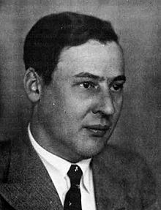
Ψ – Calculation versus Insight
Erwin with his Psi can do
calculations – quite a few.
But one thing has not been seen:
just what does Psi really mean?
Psi remains not rightly understood
Simplified, molecular orbital concepts continue to inform chemical reasoning....
E. Hückel

Slide 4
Electron Propagator
Theory
Exactness
Interpretation
Molecular Orbital
Theory
Applications

Slide 5
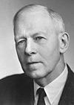
One-electron Concepts
Can an exact theory retain molecular orbital concepts?
Does electron propagator theory offer a solution to Mulliken’s dilemma?
The more accurate the
calculations become,
the more the concepts
vanish into thin air.
- R. S. Mulliken

Slide 6
One-electron Equations
Hartree Fock Theory
Hartree Fock Equations:
(T_{kin} + U_{nucl} + J_{Coul} - K_{exch})φ_{i}^{HF} ≡
F φ_{i}^{HF}=ε_{i}^{HF} φ_{i}^{HF}
Same operator for all i:
core, valence, occupied, virtual.
ε_{i}^{HF} includes Coulomb and exchange contributions to IEs and EAs
Electron Propagator Theory
Dyson Equation:
[F + ∑(ε_{i}^{Dyson})]φ_{i}^{Dyson} = ε_{i}^{Dyson} φ_{i}^{Dyson}
Self energy, ∑(E): Energy dependent, nonlocal potential that varies for each electron binding energy
ε_{i}^{Dyson} includes Coulomb, exchange, relaxation and correlation contributions to IEs and EAs
φ_{i}^{Dyson} describes effect of electron detachment or attachment on electronic structure

Slide 7
Dyson Orbitals
(Feynman-Dyson Amplitudes)
Electron Detachment (IEs)
φ_{i}^{Dyson}(x₁) =
N^{-½}∫Ψ_{N}(x₁,x₂,x₃,…,x_{N})Ψ*_{i,N-1}(x₂,x₃,x₄,...,x_{N})
dx₂dx₃dx₄…dx_{N}
Electron Attachment (EAs)
φ_{i}^{Dyson}(x₁) =
(N+1)^{-½}∫ Ψ_{i,N+1}(x₁,x₂,x₃,...,x_{N+1})Ψ*_{N}(x₂,x₃,x₄,…,x_{N+1}) dx₂dx₃dx₄…dx_{N+1}

Slide 8
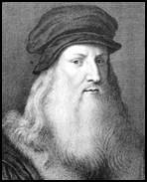
Theory and Experiment
Those sciences are vain and full of errors that are not born of experiment, the mother of certainty.
Leonardo da Vinci

Slide 9
Substituent Effects: U and T

Slide 10
Dyson Orbitals for U and T IEs
Uracil
π₁
σ₋
π₂
σ₊
π₃
Thymine
Methyl (CH₃) participation

Slide 11
Uracil versus Thymine
Methyl group destabilizes π orbitals with large amplitudes at nearest ring atom
Therefore, IE(T) < IE(U)
Valid principles for substituted DNA bases, porphyrins and other organic molecules

Slide 12
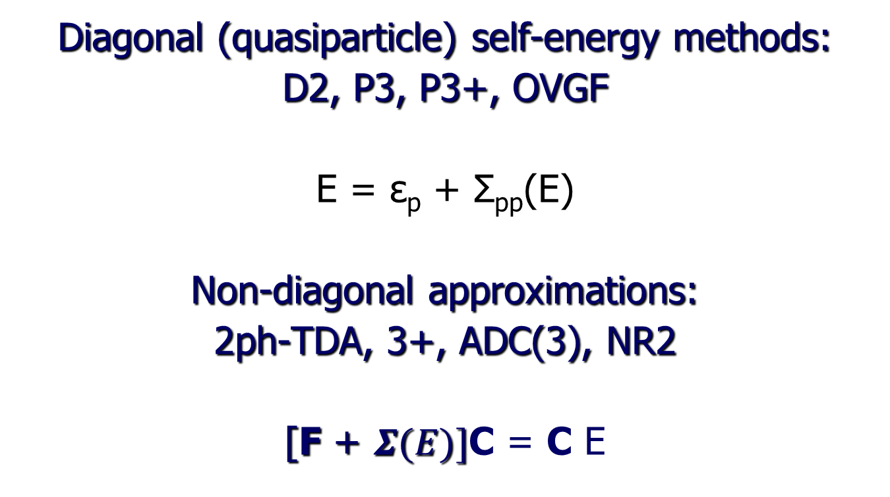
Approximate Dyson Equations in HF Canonical MO Basis
Diagonal (quasiparticle) self-energy methods:
D2, P3, P3+, OVGF
E = ε_{p} + Σ_{pp}(E)
Non-diagonal approximations:
2ph-TDA, 3+, ADC(3), NR2
[F + $Σ(E)]$C = C E

Slide 13
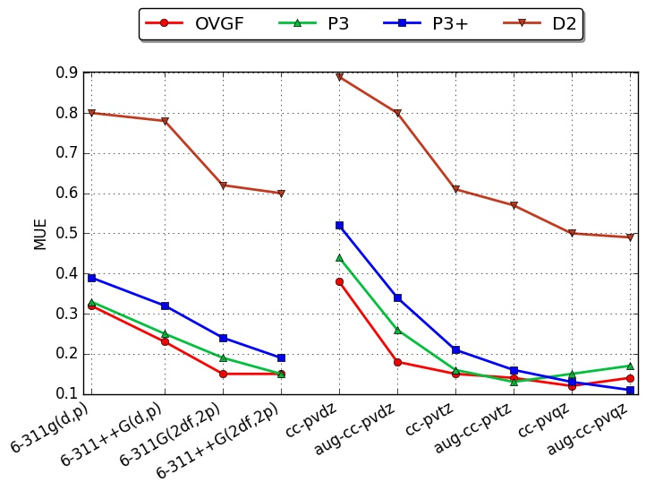
Diagonal Methods for VIEs:
Basis Set Dependence

Slide 14
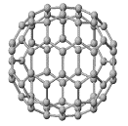
C₇₀ Photoelectron Spectrum
Final State | Koopmans | OVGF | Expt. (eV)
²A₂” | 7.54 | 7.45 | 7.47
²E₁” | 7.60 | 7.47 | 7.47
² A₂’ | 8.06 | 7.63 | 7.68
² E₂’ | 8.48 | 7.94 | 7.96
² E₂” | 8.58 | 8.09 | 8.12
² E₁’ | 8.82 | 8.42 | 8.43

Slide 15
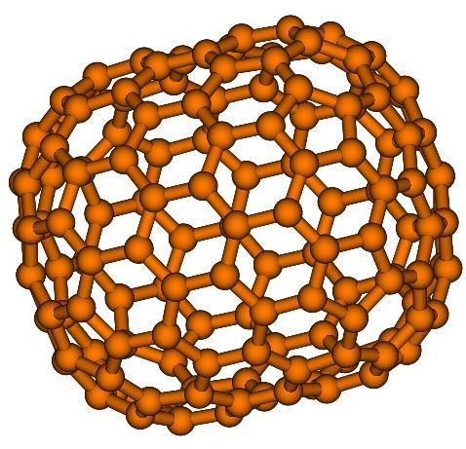
Predicted Ionization Energies of D_{6h} Isomer of C₁₄₄
Retain all valence occupied MOs
Reduce virtual space dimension 50%
Koopmans | OVGF
7.04 | 6.87
7.13 | 6.86
7.47 | 7.12
7.85 | 7.57
7.91 | 7.31
All OVGF pole
strengths > 0.86

Slide 16
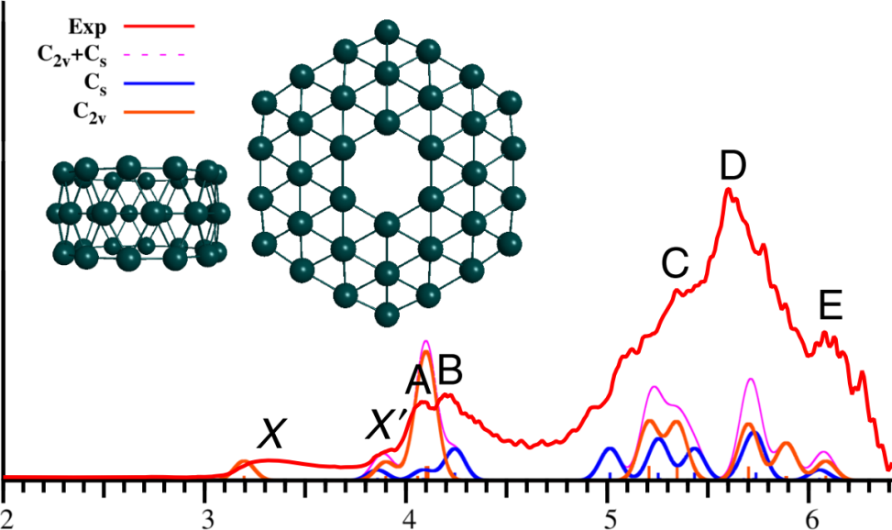
B₃₆⁻ Photoelectron Spectrum
Anion PES by L.S. Wang & coworkers
Intensities of OVGF-C EDEs inferred from X and X’ intensities
CCSD(T) | Bowl | Ring
Anion | 0 | 10 kcal/mol
Molecule | 0 | 22 kcal/mol

Slide 17
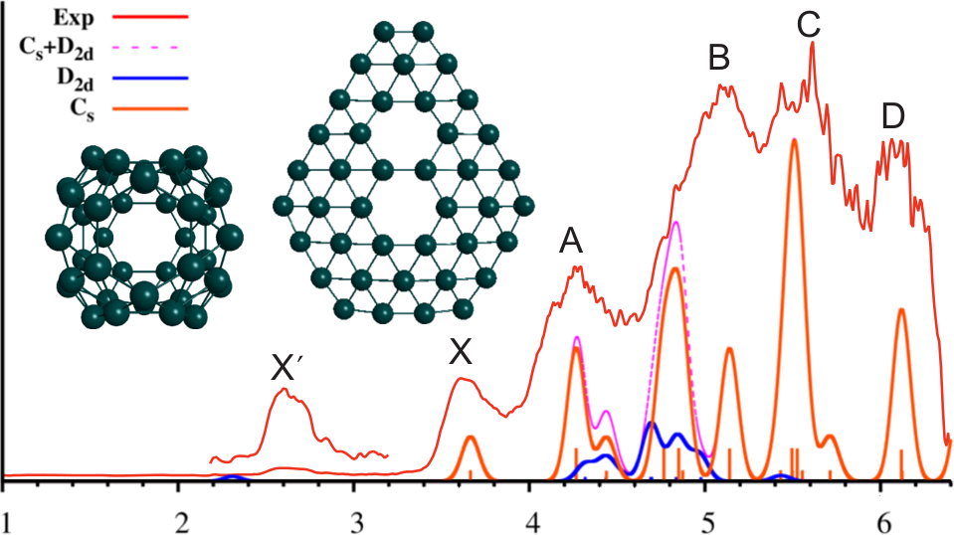
B₄₀⁻ Photoelectron Spectrum
Photoelectron
spectrum:
L.S. Wang &
coworkers
CCSD(T) | 2-D | 3-D
Anion | 0 | 4 kcal/mol
Molecule | 32 kcal/mol | 0

Slide 18
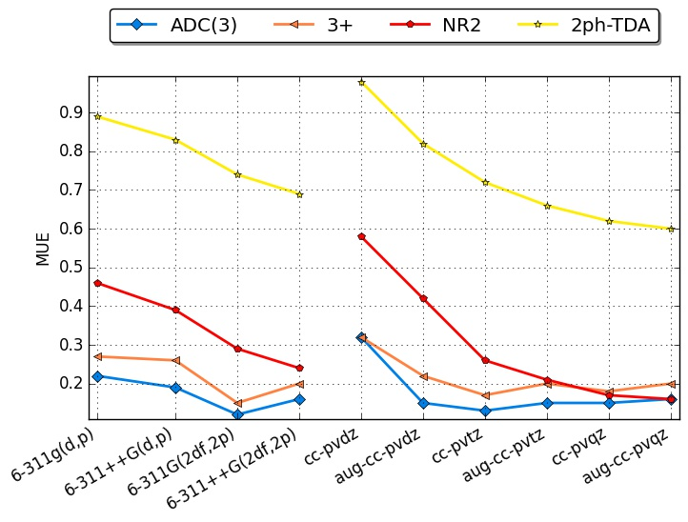
Nondiagonal Methods for VIEs:
Basis-Set Dependence
Best convergence: NR2
Best accuracy: NR2
ADC(3) and 3+ worsen slightly after triple ζ

Slide 19
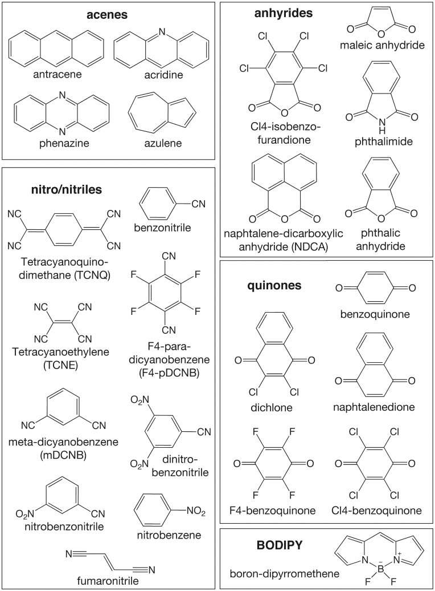
Electron Acceptor Benchmarks
Compare predictions of vertical IEs & EAs
EP methods versus CCSD(T)
Correlation-consistent basis sets
Perform basis-set extrapolations

Slide 20
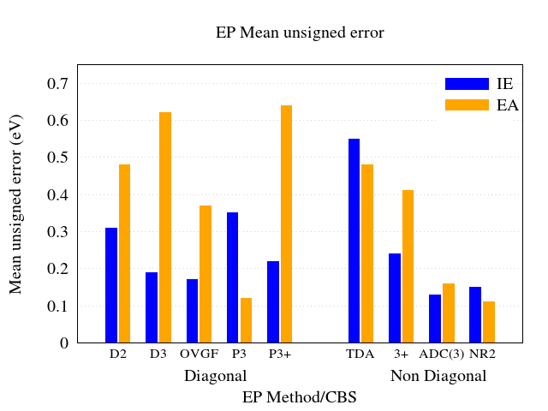
Efficiency & Accuracy
Identify best compromises
Full Σ(E): NR2 for IEs and EAs
Diagonal Σ_{pp}(E): P3+ for IEs and P3 for EAs

Slide 21
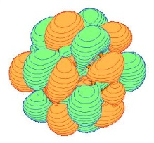
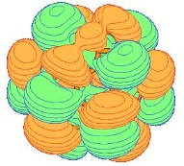
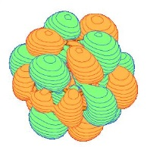
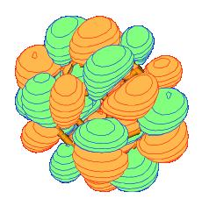
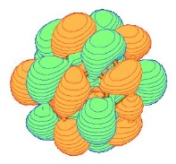
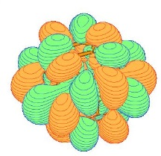
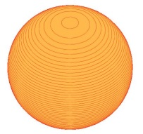
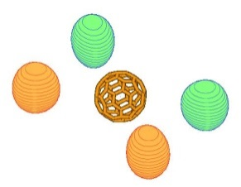
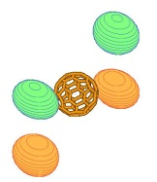
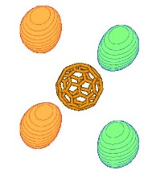
C₆₀ Σ^{NR2}(E) Vertical
Electron Affinities (eV)
t_{1u} - valence
2.09
t_{1g} - valence
0.86
a_{g} - diffuse
0.11
t_{2u} - diffuse
0.04

Slide 22
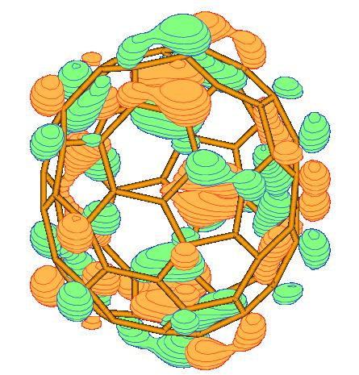
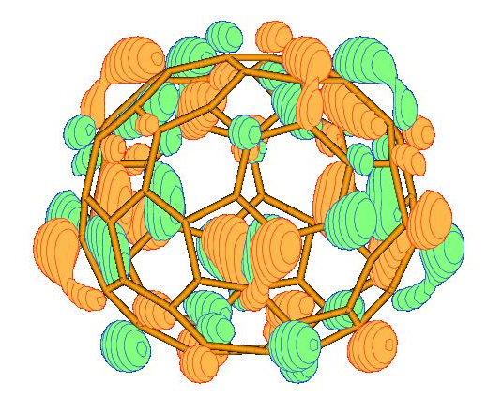
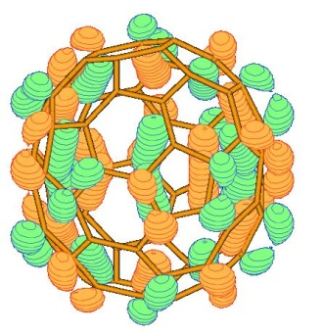
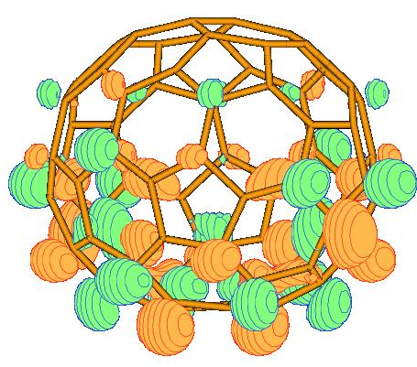
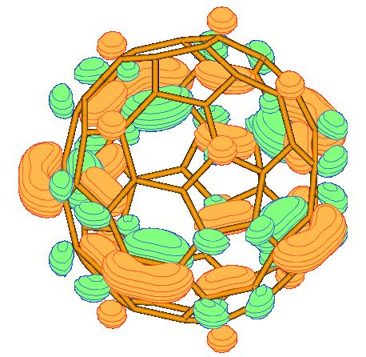
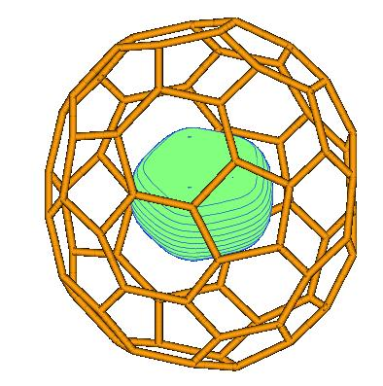
C₇₀ Σ^{NR2}(E) Vertical
Electron Affinities (eV)
2.09 e₁
1.23 e₁
1.93 a₁
0.35 e₂
1.59 a₁
0.16 a₁

Slide 23
Fullerene Anions
Ground and several excited states of fullerene anions are vertically bound with respect to uncharged molecules
Excited fullerene anions may bind electrons in valence or diffuse orbitals

Slide 24
Diverse Insights from
Electron Propagator Theory
Ab initio prediction and interpretation of spectra and energetics
Rigorous, one-electron concepts deepen and generalize qualitative chemical notions

